Slide 1


Shared Safety Net Action Plan (SSNAP)
Training for Users in Control Practices

Slide 2


What we’ll cover today
Why is the research needed?
What will it involve?
Which patients are eligible?
Coding for SSNAP.

Slide 3
Why is this research needed?

Slide 4

Why do we need SSNAP?
Delayed diagnosis of cancer major cause of mortality.
Early-stage diagnosis across 13 most common cancers 60% Sept 2025, around 58% in West Yorkshire, compared to target in NHS Long Term Plan to increase % cancers diagnosed early to 75% by 2028.
Over three million referrals for investigation on urgent suspected cancer pathways from primary to secondary care over last year, doubled over last decade.
Safety-netting provides a valuable tool but vulnerable to delay, misunderstanding, varying levels of patient engagement. E.g. recent review of general practice indemnity claims found safety-net instructions often lacked detail, contributing to poor monitoring and follow up of symptoms.

Slide 5


What is SSNAP?
SSNAP (Shared Safety Net Action Plan) aims to engage patients in safety-netting about non-specific symptoms that could be a sign of cancer, to support early diagnosis.
Co-designed by patients & primary care staff.
Not a clinical decision-support tool.
SSNAP records outcomes of safety-netting consultations in SystmOne when patients present with uncertain symptoms. The tool provides patients with an electronic or paper version of SSNAP to support patients in understanding which symptoms to monitor, for how long, and in which circumstances to reconsult.
Also provides ways to follow patients up via scheduled tasks & reminders.
Notes:
Could assist with meeting Jess’ Rule? “Three strikes & rethink approach"

Slide 6
What will the research involve for us?

Slide 7

The Study
Feasibility trial in 6 general practices in Bradford & Airedale (3 intervention, 3 control).
Aims to assess the feasibility and acceptability of SSNAP to support earlier diagnosis of cancer in general practice
This research will then inform design of a subsequent large clinical trial.

Slide 8
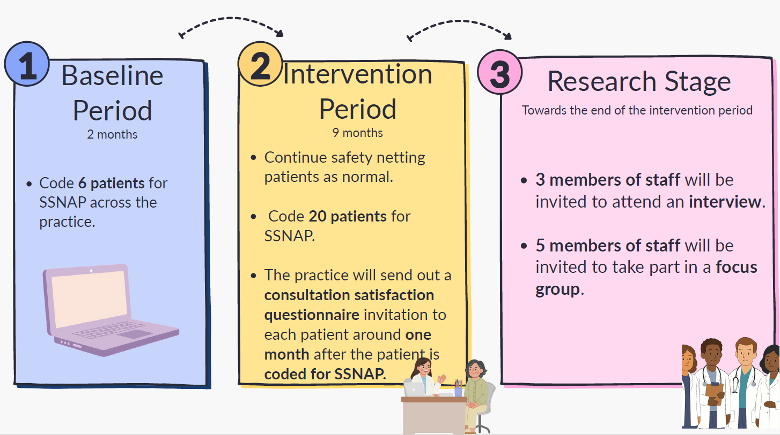
What’s required of your practice?

Slide 9
Which patients are eligible for SSNAP?

Slide 10



Which patients are eligible for SSNAP?
Young people and children under 18 years.
Patients 18 years or older with non-specific symptoms which could indicate cancer.
Patients without capacity who are not accompanied by a consultee.
Patients must have capacity or accompanied by family member or informal carer (consultee) >18.
Opted out of data sharing.
No need to take patient consent in this study; posters will be displayed so they know about the study and how to opt out.
Notes:
How do you know if you’ve recruited enough patients? PI will let you know when to stop?
Won’t know if opted out of data sharing or not but Connected Bradford will remove patients who have opted out from the data that’s given to research team.
Patients must have capacity to decide on own medical treatment or without capacity but accompanied by family member or informal carer (consultee) aged 18 years or older.
Patients aged 18 years or older who do not have capacity to consent to their own medical treatment and are not accompanied by consultee aged 18 years or older.
Exclusion
Young people and children <18 years.
Patients >18 years who do not have capacity to consent to own medical treatment & either not accompanied by consultee >18 years, or consultee does not agree to receiving SSNAP.
Opted out of data sharing.

Slide 11
Which patients complete a questionnaire?
Patients, family members/informal carers under the age of 18.
Patients 18 years or older who received SSNAP.
Family members/informal carers of patients who received SSNAP but passed away before invitation to complete a questionnaire circulated.
Family members/informal carers (>18) who accompanied patients in consultations where SSNAP was used.
Patients who could be distressed or confused by participating, inc. those who lack capacity to consent or are too ill.
Notes:
Exclusion
Young people and children <18 years.
Patients >18 years who do not have capacity to consent to own medical treatment & either not accompanied by consultee >18 years, or consultee does not agree to receiving SSNAP.
Opted out of data sharing.

Slide 12
Coding for SSNAP

Slide 13
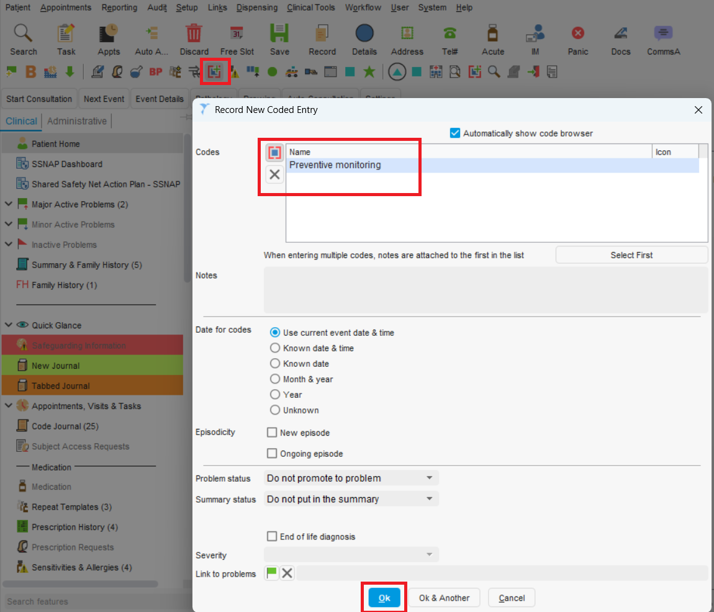
Coding for SSNAP in Baseline Period
Use code “Preventive monitoring (Xa97Q)” to identify patients eligible for SSNAP. During baseline period, enter code into consultation box when you consider a patient meets eligibility criteria:
Click the Add Clinical Code Button.
Search for the code Preventative Monitoring (Xa97Q)
Click OK (or your practice may add an auto-consult)
Aim to code 6 patients across practice over 2-month baseline period. No need to take consent.
Notes:
You will be advised when baseline period starts & ends.
No need to take consent –will only review data of patients already signed up for data sharing with Connected Bradford.

Slide 14

Coding for SSNAP in Intervention Period
During this time, continue to code eligible patients for SSNAP inclusively, as in baseline.
Aim to code 20 patients for SSNAP across practice over 9-month intervention period.
No need to take consent.
Notes:
You’ll be advised when intervention period starts & ends.
Patients should have seen poster about SSNAP in practice and could ask if they’ve seen it.

Slide 15

Inviting patients to complete a questionnaire
Around 4 weeks after initial consultation, practices invite SSNAP-coded patients to complete consultation satisfaction questionnaire (online or post).
Research team will provide wording for mobile phone text, email or letter plus SAEs, paper patient information sheets & questionnaires for patients without digital access.
Search for these patients monthly using “Preventive monitoring” (Xa97Q) or ICB can provide monthly report which shows all SSNAP-coded patients in last 4 weeks.
Notes:
Patients should have seen poster about SSNAP in practice and could ask if they’ve seen it.

Slide 16
Support & Further Information

Slide 17

Further Guidance
Further information about SSNAP study – including copy of these slides - will be available online.
Dr Hannah Gregson, Research Fellow: Hannah.Gregson@bthft.nhs.uk
Dr Lynn McVey, Chief Investigator: Lynn.McVey@bthft.nhs.uk

Slide 18
Support & Further Information
This study is funded by the National Institute for Health and Care Research (NIHR) [Research for Patient Benefit (NIHR208819)]. The views expressed are those of the author(s) and not necessarily those of the NIHR or the Department of Health and Social Care.
We’d also like to acknowledge the colleagues, NHS staff, patients and members of the public who have contributed to co-development of the SSNAP tool and of this study.
Acknowledgements

Slide 19

Thank you!

