Slide 1


Shared Safety Net Action Plan (SSNAP)
Training for Users in Intervention Practices

Slide 2


What we’ll cover today
Why has SSNAP been developed?
What will this research involve?
Which patients are eligible for SSNAP?
Using SSNAP in SystmOne
Using SSNAP inclusively with patients

Slide 3
Why has SSNAP been developed?

Slide 4


Why do we need SSNAP?
Delayed diagnosis of cancer major cause of mortality.
Early-stage diagnosis across 13 most common cancers 60% Sept 2025, around 58% in West Yorkshire, compared to target in NHS Long Term Plan to increase % cancers diagnosed early to 75% by 2028.
Over three million referrals for investigation on urgent suspected cancer pathways from primary to secondary care over last year, doubled over last decade.
Safety-netting provides a valuable tool but vulnerable to delay, misunderstanding, varying levels of patient engagement. E.g. recent review of general practice indemnity claims found safety-net instructions often lacked detail, contributing to poor monitoring and follow up of symptoms.
Notes:
https://digital.nhs.uk/ndrs/data/data-outputs/cancer-data-hub/rapid-cancer-registration-data-dashboards
NHS Resolution. October 2025. Delayed diagnosis of cancer: a thematic review of general practice indemnity claims

Slide 5

What is SSNAP?
SSNAP (Shared Safety Net Action Plan) aims to engage patients in safety-netting about non-specific symptoms that could be a sign of cancer, to support early diagnosis.
Co-designed by patients & primary care staff.
Not a clinical decision-support tool.
SSNAP records outcomes of safety-netting consultations in SystmOne when patients present with uncertain symptoms. The tool provides patients with an electronic or paper version of SSNAP to support patients in understanding which symptoms to monitor, for how long, and in which circumstances to reconsult.
Also provides ways to follow patients up via scheduled tasks and reminders.

Slide 6
What will the research involve?

Slide 7

The Study
Feasibility trial in 6 general practices in Bradford & Airedale (3 intervention, 3 control).
Aims to assess feasibility and acceptability of SSNAP to support earlier diagnosis of cancer in general practice.
This research will then inform design of a subsequent large clinical trial.

Slide 8
What’s required of your practice?

Slide 9
Which patients are eligible for SSNAP?

Slide 10





Which patients are eligible for SSNAP?
Patients without capacity who are not accompanied by a consultee.
Patients 18 years or older with non-specific symptoms which could indicate cancer.
Consultee does not agree to receiving SSNAP.
Patients must have capacity or accompanied by family member or informal carer (consultee) >18.
Young people and children under 18 years.
No need to take patient consent in this study; posters will be displayed so they know about it & how to opt out.
Opted out of data sharing.

Slide 11
Which patients can take part in the questionnaire & interview?
Patients, family members/informal carers under the age of 18.
Patients 18 years or older who received SSNAP.
Family members/informal carers of patients who received SSNAP but passed away before invitation to complete a questionnaire circulated.
Family members/informal carers (>18) who accompanied patients in consultations where SSNAP was used.
Patients who could be distressed or confused by participating, inc. those who lack capacity to consent or are too ill.

Slide 12
Using SSNAP in SystmOne

Slide 13
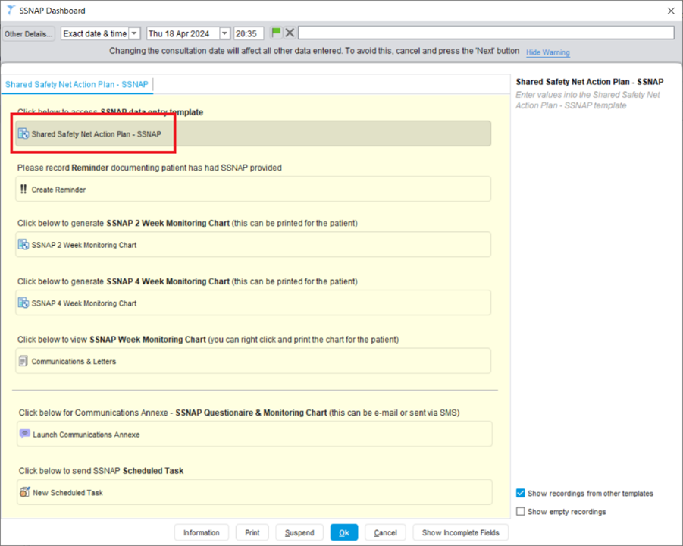
SSNAP Dashboard
Using template generates date-stamped code “Preventive monitoring” (Xa97Q) - identifies patient as receiving SSNAP.
Notes:
Retrieve patient record & locate SSNAP Dashboard on tree in SystmOne.
Click on Shared Safety Net Action Plan > SSNAP template.

Slide 14
Recording SSNAP Eligibility in Baseline
In 2-month baseline period record 6 patients eligible for SSNAP: don’t give SSNAP plan to patients.
E.g. add ‘B’ (for baseline) to duration field in SSNAP template.
B
Notes:
You will be advised when baseline period begins & ends.

Slide 15
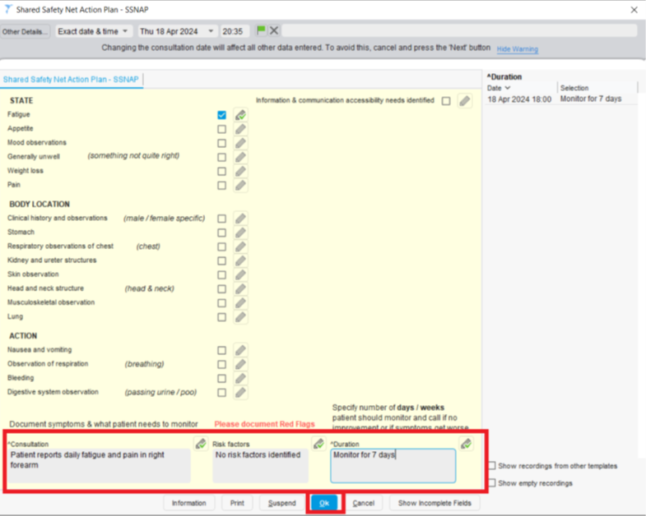
Using SSNAP in Intervention Period
If patient eligible for SSNAP, tell them practice is involved in research about symptoms that could have different causes.
Involves giving them a copy of any next steps you agree together during the consultation. This is called their Shared Safety Net Action Plan.
Note when you are tired
Notes:
You’ll be advised when intervention period starts & ends.
If patient does not want to take part, it won’t affect their care. Revert to normal (pre-SSNAP) safety-netting process & don’t complete SSNAP template. If you’ve started the template, delete it.

Slide 16
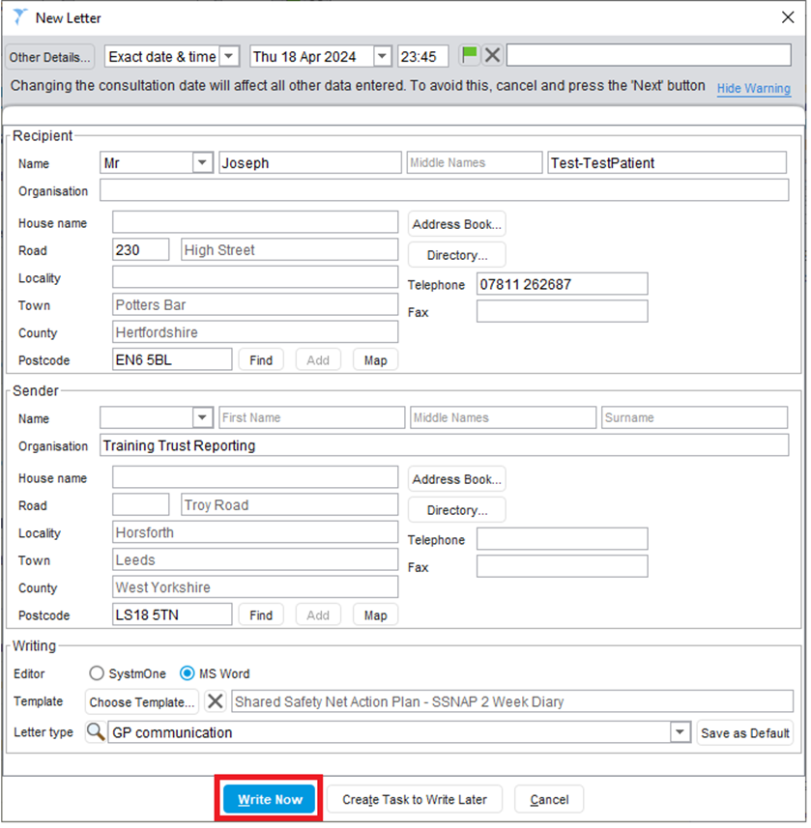
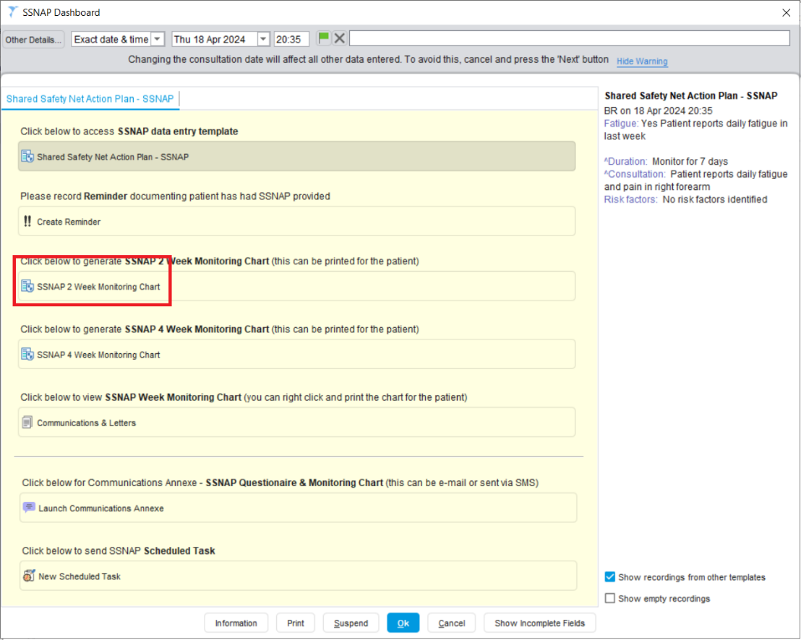
Creating Patient Letter & Monitoring Chart
Click on ‘Monitoring Chart’ (2 or 4 week) quick action button on SSNAP dashboard.
Notes:
‘New Letter’ box should be pre-populated with information regarding sender & recipient.
Click ‘Write Now’ to generate letter.

Slide 17
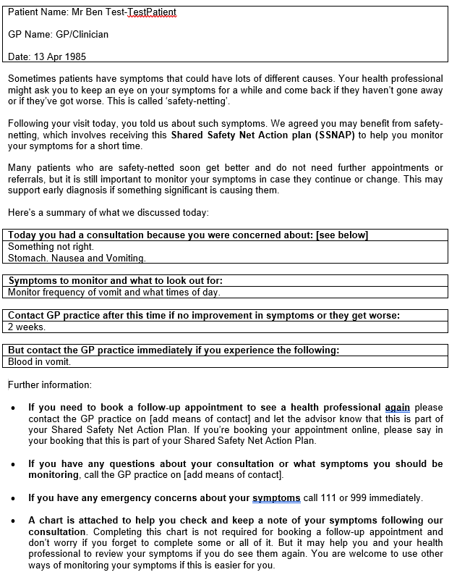
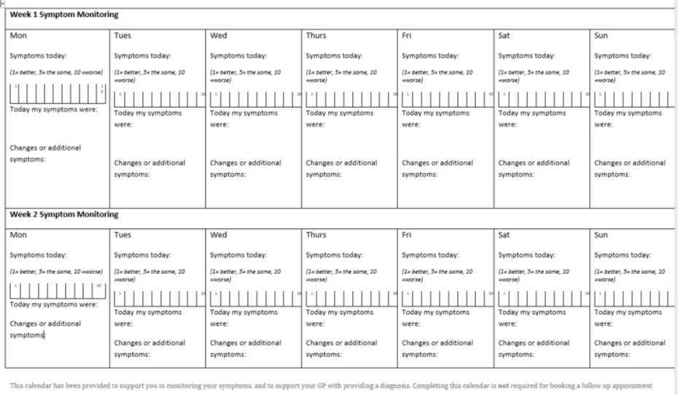
Microsoft Word launches and provides SSNAP letter, including Monitoring Chart.
Monitoring chart also generated (2 or 4 weeks as selected).
Notes:
Content entered in SSNAP template merges into corresponding boxes in letter.
Check content before selecting ‘Save Final Version’. Locks letter for future editing.

Slide 18
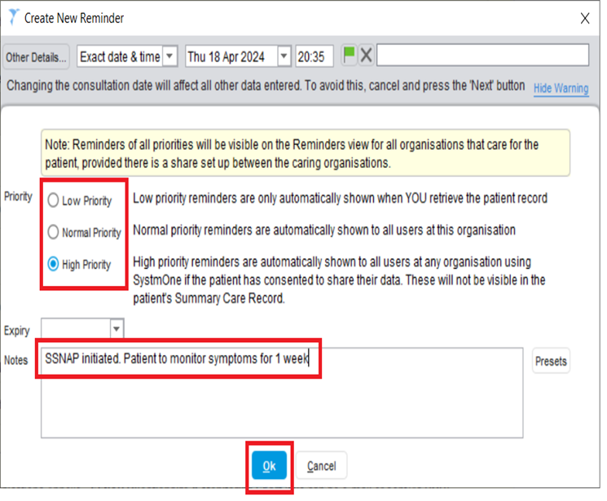
Following Patients Up
SSNAP dashboard incorporates reminders and scheduled tasks to follow patients up.
Use reminders to show colleagues that patient has been safety-netted using SSNAP.
Patient safety-netted with SSNAP

Slide 19
Using SSNAP inclusively with patients

Slide 20
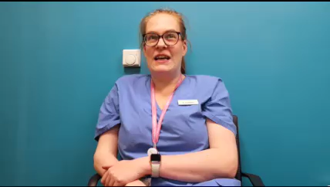

Slide 21
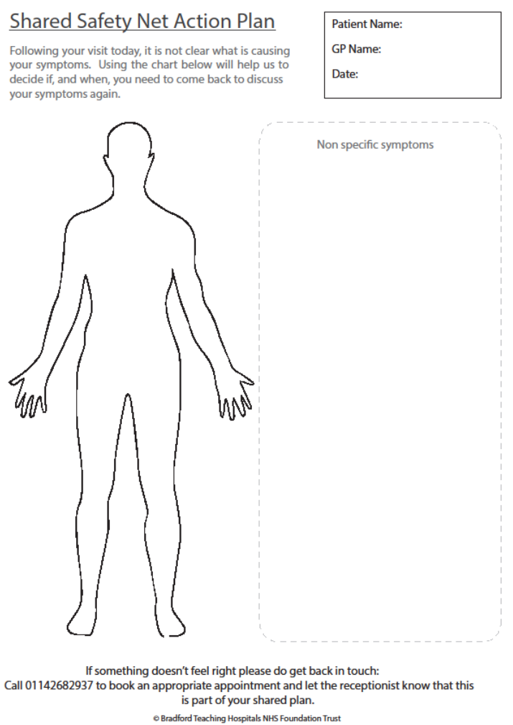
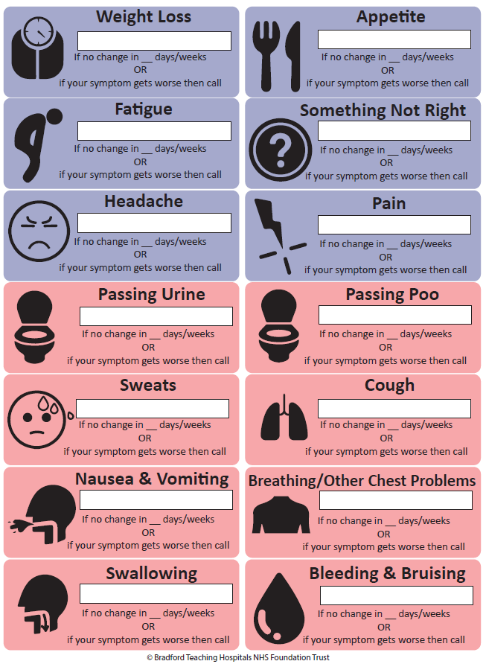
Using SSNAP inclusively
Paper version of SSNAP includes body map & symptom stickers.
Notes:
This may be useful when using SSNAP with patients living with dementia or learning differences; those who don’t have English as a first language; who are supported by families or informal carers; people without digital access; and those having difficulty understanding symptoms/location of symptoms (e.g. kidney pain).

Slide 22
To Use Paper SSNAP…
Affix relevant stickers to area next to body chart to show which symptoms patient needs to monitor & where they are located.
Add information to support patient monitoring and time-period beyond which, if symptoms persist or worsen, patient should arrange follow-up appointment.
Notes:
Complete the SystmOne digital SSNAP template as usual but don’t print or email letter & chart. Instead complete paper SSNAP with patient or carer.

Slide 23
Support & Further Information

Slide 24

Manual, technical video & further information about SSNAP study – including a copy of these slides - will be available online.
Dr Hannah Gregson, Research Fellow: Hannah.Gregson@bthft.nhs.uk
Dr Lynn McVey, Chief Investigator: Lynn.McVey@bthft.nhs.uk
Technical support with SSNAP template: wyicb.dataqualityteam@nhs.net

Slide 25
Support & Further Information
This study is funded by the National Institute for Health and Care Research (NIHR) [Research for Patient Benefit (NIHR208819)]. The views expressed are those of the author(s) and not necessarily those of the NIHR or the Department of Health and Social Care.
We’d also like to acknowledge the colleagues, NHS staff, patients and members of the public who have contributed to co-development of the SSNAP tool and of this study.
Acknowledgements

Slide 26

Thank you!

